Slide 1






Observation • Understanding • Action
Your pathway to liveable cities
Paid Partnership
Prospectus
auo.org.au

Slide 2
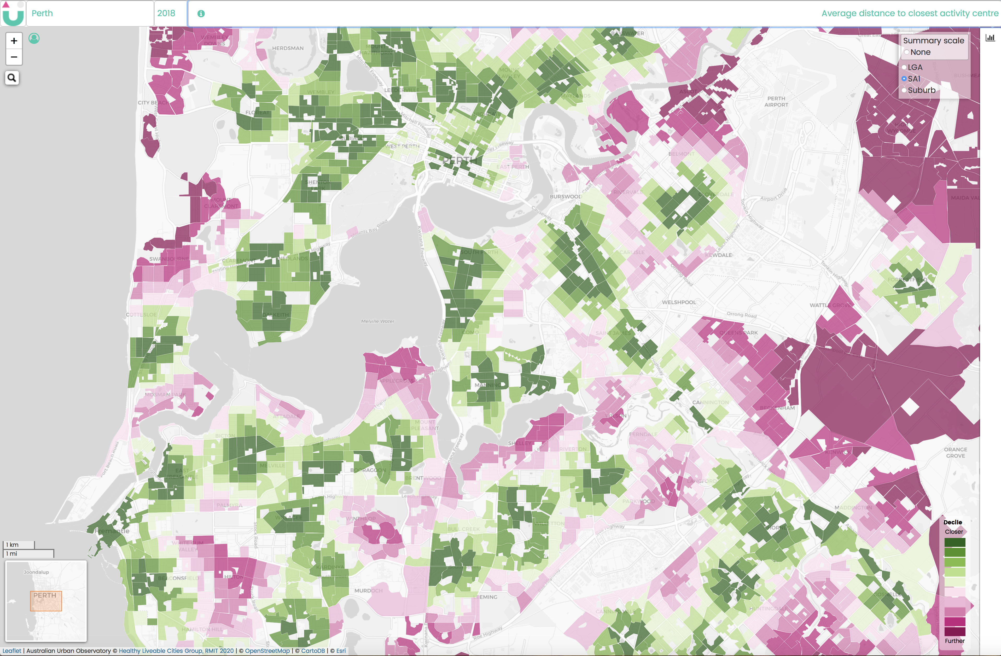
How do we create liveable cities?
We live in an urbanising world. Cities are increasing in prominence as major social and economic hubs. For such cities, liveability rankings and awards can provide welcome global recognition and marketing tools.
Rankings may attract people to a community or encourage them to look elsewhere. Many people will know Melbourne has been repeatedly voted the “world’s most liveable city”.
The key question is: liveable for whom?
While helpful at the broadest level, these rankings focus on the inner city, remuneration packages and economic productivity. The rankings mask intra-city inequities.
To overcome this, our definition of liveability considers the underlying conditions that support health. We focus on equity and recognition that where you live can predict health outcomes and life expectancy.
We have created liveability indicators that are linked to urban, transport and infrastructure planning policy. We are guided by our understanding that health is influenced by individual personal factors, social and community supports and broader socioeconomic, cultural and environmental conditions – known collectively as the social determinants of health.
We need to build cities based on a clear and consistent definition of liveability. The goal is that it can be objectively measured and tracked over time using indicators that provide an understanding of each city’s strengths and challenges.
Introducing the Australian Urban Observatory
The Australian Urban Observatory (AUO) is an important new digital planning tool that maps liveability across Australia's 21 largest cities.
The AUO’s spatial maps translate policy-based urban research into real-world practice. Our liveability maps enable a deeper understanding of how social, economic, natural and built environments connect to support community health and wellbeing.
Through the AUO, decision makers can create a positive impact for people in local communities by establishing a strong evidence base for future infrastructure planning.
.

Slide 3



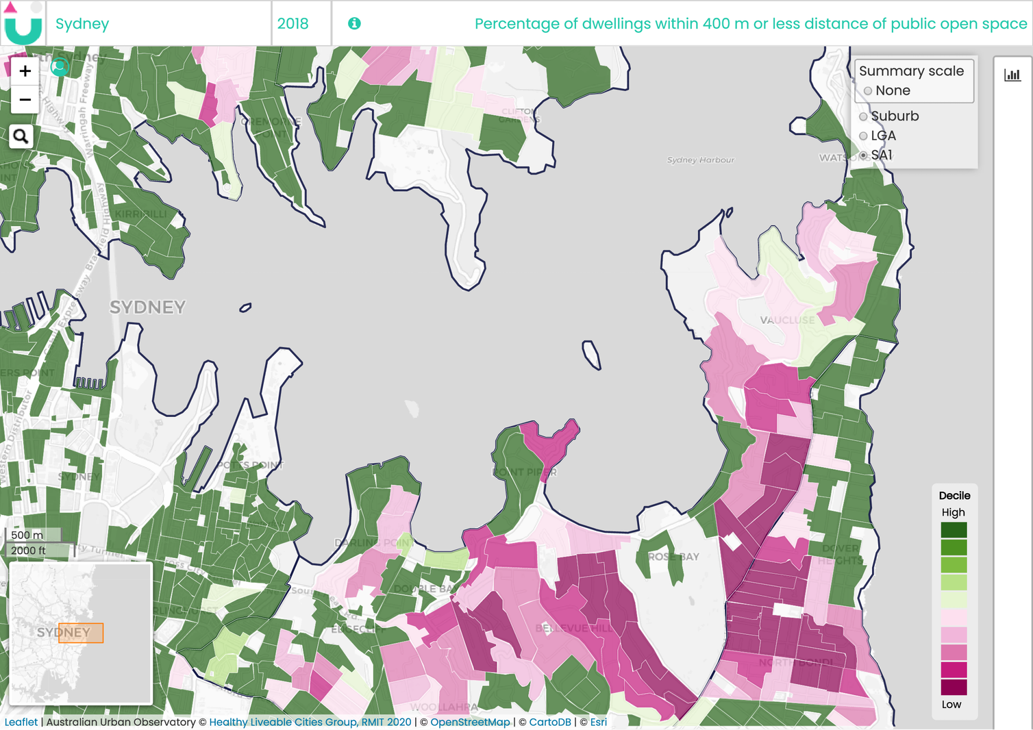






Mapping key liveability indicators
The AUO’s liveability indicators are underpinned by years of policy-relevant urban research by our team from RMIT University. Research that connects the built environment with public health, social equity and the UN Sustainable Development Goals.
Each of our detailed indicators falls into one of nine liveability categories:
Let’s take an example …
Accessible public open space is a key ingredient of healthy and liveable places. Public green spaces provide multiple benefits for mental and physical health, urban cooling, biodiversity, air pollution and stormwater runoff as identified in our previous review for the Heart Foundation.
Access to local public open spaces has become even more important as the current need to stay home adds to the impacts of increased density in the form of smaller houses, lot sizes and apartment living. Yet not everyone has access to local parks.
Liveability | Walkability | Social Infrastructure
Transport | Food | Alcohol
Public Open Space | Employment | Housing
Looking at one of our public open space indicators – ‘Percentage of dwellings within 400 metres of public open space’ - not all neighbourhoods have access to public open space within 400 metres.
The AUO provides comprehensive liveability information across Australia’s 21 largest cities. These 21 cities, including 8 capital cities and 13 other major regional cities with a population of 80,000 or more, link the AUO to the National Cities Performance Framework.
We map to three levels of detail, covering 170 Local Government Areas, 3,101 Suburbs and 39,967 Neighbourhoods (ABS SA1s).
We see this in neighbourhoods just north of the beach in North Bondi, Sydney, as the liveability map below shows. We found a similar pattern in neighbourhoods of St Kilda East in Melbourne. It’s a pattern repeated in many neighbourhoods across cities in Australia.
The AUO is annually updated and new indicators are regularly added. Visit the AUO to learn more about our liveability indicators, their rationale & methodologies, SDG links and research references.

Slide 4
Creating value for you
Supporting engagement, planning and decision making
Leverage our research to support health and wellbeing in your community. AUO indicators provide a suite of liveability measures that enable the setting of clear targets for improvement and tracking changes over time with annual updates.
This new digital planning tool is a user-friendly single portal with information that is easily shared across organisations and the community, supporting integrated planning approaches.
Knowing where to focus infrastructure spending that provides the greatest return on investment is always hard. The AUO gives you a clear understanding of where to invest for liveability in your community.
Saving you time and money
The AUO will save you time and money spent on staff and external consultants dedicated to data collation and analysis, reducing inefficiencies and data duplication.
Through the AUO you will be able to access years of research expertise and insights that have been developed by our multidisciplinary team at RMIT’s Centre for Urban Research.
Our team of researchers draws experience from epidemiology, behavioural science, geography, geomatics, psychology and public health using a variety of quantitative and qualitative analyses including geospatial, policy and economic evaluations.
Liveability at your fingertips
We’ve made understanding liveability so much simpler. We’ve taken data out of the tables and put it on the map. We’re supporting observation, that leads to understanding and action that improves liveability.
Planners and policy makers use the AUO to:
Understand details of liveability at a very granular level
Identify liveability strengths and weaknesses in their community
Analyse existing liveability strategies
Develop new policies to support health and wellbeing
Make comparisons with similar demographics nationally
Decide where to focus future investment
Build an evidence base to advocate for policy change
Monitor the impact of liveability strategies over time
Developers and consultants use the AUO to:
Connect deliverables with Corporate Social Responsibility targets
Develop project specific liveability strategies
Identify the opportunities and risks of new places to invest
Build business cases for future projects
Understand liveability at national, regional and local levels
Journalists use the AUO to:
Access policy-based urban liveability research
Measure the impact of policy agendas
Learn how liveability changes across different locations and cities
Identify issues for rural cities and how these differ from capitals
Measure the major influences of liveability

Slide 5
Our impact in Mitchell Shire
“Advocacy is just another word for nagging but with an evidence base.
“That is what the Australian Urban Observatory helps you to do, build the evidence base for what may seem obvious, but to government you cannot sell anything based on intuition.
“It has helped Mitchell Shire create a starting point for each key town and growth area that is specific it, assisting in developing specific support or interventions that are not generic across the Shire.
“The indicators have also helped with the Seymour Revitalisation project providing the evidence that was utilised to develop a business case for a community/primary care hub, that was submitted to the State for consideration. Seymour is one of the most disadvantaged postcodes in Victoria, the liveability indicators provide a deeper understanding. We can now utilise the indicators (as they were at the start of the project) and measure whether targeted interventions have been successful in a couple of years.
“In new neighbourhoods, setting the culture/course early through monitoring, assessing and responding have long term positive impacts. Monitoring liveability at periodic checkpoints (every 2/3 years), can help you plan, ensuring you don’t bed entrenched issues, that can take years of retrofitting to address.”
Mary Agostino
Acting Chief Executive Officer
Mitchell Shire Council
Partner with us
If you want to be part of the solution to improving liveability in Australia, supporting healthy, equitable and sustainable cities for all, then become a Paid Partner with us.
You’ll be leveraging the Australian Urban Observatory’s key liveability indicators, utilising our groundbreaking policy-relevant urban research linking the built environment and public health, developed by our team at RMIT’s Centre for Urban Research.
The AUO has two levels of accessibility. All indicators to a Local Government Level, as well as the Liveability Index and Social Infrastructure Index to Suburb and Neighbourhood levels, are available without charge. All other Suburb and Neighbourhood indicators are available through AUO Paid Partnerships. Contact us to learn more about Paid Partnerships.
LGA Paid Partner A Single LGA Interactive indicators and scorecards for Suburbs and Neighbourhoods for a Single Local Government Area 12 months online access extending to EOFY¹ | State Paid Partner A Single State Interactive indicators and scorecards for Suburbs and Neighbourhoods for a Single Australian State 12 months online access extending to EOFY² | National Paid Partner All 21 Cities Interactive indicators and scorecards for Suburbs and Neighbourhoods for All 21 Cities Nationally 12 months online access extending to EOFY
¹ Multiple Local Government Areas can be selected at $7,500 per LGA
² Multiple states can be selected at $50,000 per state

Slide 6
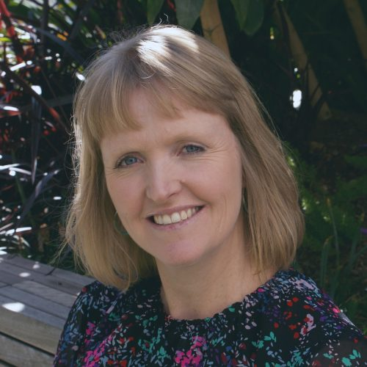








Our key supporters
Our research is recognised and funded by top Australian medical and scientific research organisations including:
Contact
Dr Melanie Davern
Associate Professor Fellow
Director Australian Urban Observatory
melanie.davern@rmit.edu.au
Katherine Murray
Partnerships & Development
Australian Urban Observatory
katherine.murray@rmit.edu.au
Australian Urban Observatory
auo.org.au
Centre for Urban Research
Building 8, Level 11
RMIT University City Campus
auo@rmit.edu.au

