Slide 1
— Research Data Management @ RMIT
https://www.rmit.edu.au/library/research/research-presentations-and-drop-in-assistance
Library Seminars for Researchers
Notes:
SAM - Introduction

Slide 2
Acknowledgement of country
Notes:
SAM – Your acknowledgements are always top notch

Slide 3
Presenters
Adam Rivett, Research Data and Repository, RMIT Library (adam.rivett@rmit.edu.au)
Sam Gibbard, Coordinator, Research Services, RMIT Library (sam.gibbard@rmit.edu.au)
Dr Andrew Martin, School of Physics, RMIT (andrew.martin@rmit.edu.au)
Professor Dinesh Kumar, School of Electrical and Biomedical Engineering, RMIT (dinesh.kumar@rmit.edu.au)
Notes:
SAM – quickest of overviews here – we'll talk for a bit about RDM briefly on a few fronts, and then Andrew and Dinesh can add a useful human perspective on a topic that can otherwise be pretty dry and abstract. Emphasise that this is a general overview, and each of these topics can be drilled into later or in private consultation

Slide 4
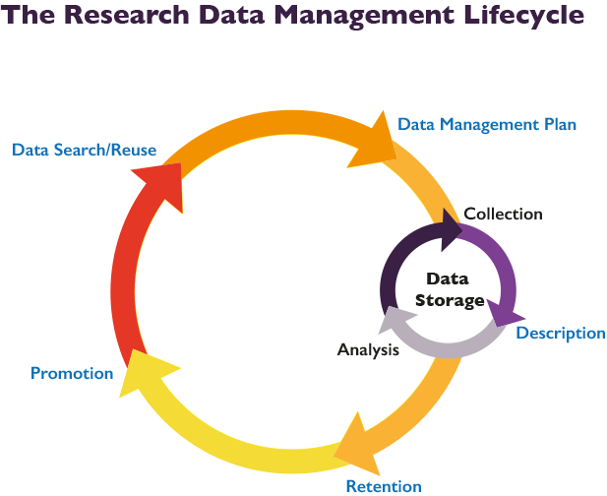
Notes:
ADAM – I'll take the opening slides. This is a good way of way of conceptualising the larger issues, and touches upon all the key concepts.

Slide 5
FAIR Data Principles
Findable
Can your data be found if someone is looking for it? Does it have a DOI or a Handle? Does it have rich metadata? Is it discoverable through a research portal, or a repository?
Accessible
Does your data utliise a standardised protocol? Your data does not necessarily have to be "open" - there are sometimes good reasons why data cannot be made open, i.e. privacy concerns, national security or commercial interests - but if it is not there should be clarity and transparency around the conditions governing access and reuse.
Interoperable
To be interoperable the data will need to use community agreed formats, language and vocabularies. Will someone who finds your data be able to meaningfully reuse it, and build or reproduce your work? The metadata you use will also need to use a community agreed standards and vocabularies, and contain links to related information using identifiers.
Reusable
Reusable data should maintain its initial richness. For example, it should not be diminished for the purpose of explaining the findings in one particular publication. It needs a clear machine readable licence and provenance information on how the data was formed. It should also have discipline-specific data and metadata standards to give it rich contextual information that will allow for reuse.
Notes:
ADAM – I'll take this too. Some of these concepts echo in the Figshare slide and I'll do that too.

Slide 6
Research Integrity
RMIT University values the contribution of researchers and participants to the collection of research data. We recognise the importance of research data in supporting research findings, contributing to further research and discussion, and enabling public trust in research. It is important that research data are managed well throughout the data lifecycle, to respect any legal requirements and confidentiality, ethics and privacy concerns; and so that the data are secure and reusable.
https://www.rmit.edu.au/about/governance-and-management/policies/research-policy
https://www.rmit.edu.au/about/governance-and-management/policies/research-policy/research-data-management-process
Queries: researchintegrity@rmit.edu.au
Notes:
ADAM = I'll BREEZE through this – but we should mention it and it provides another contact point for these issues, so we can say we covered it.

Slide 7
What to include in your Data Management Plan
A description of the research data - include the type and quantity of data, the format it is saved in and where it is stored
Access arrangements, both during and after the research project
How data reuse/sharing will be enabled
Any access, reuse or confidentiality restrictions
Intellectual Property ownership and copyright
How long the data needs to be retained for
Any disposal or destruction conditions
Guidelines: http://mams.rmit.edu.au/e9xncqs3y1w1.pdf
Notes:
SAM – you can mention Dan here too maybe, and the importance of defining your plan clearly.

Slide 8
ITS / Storing Data
Your RMIT Home or H: drive - Password protected / one user access / 20GB storage limit / backed up / off campus access / retain data here after research project is complete
Set up an RMIT Shared drive - Same access and storage as above, but team access can be assigned
Nectar - Supported by Australian government and linked with RMIT / Secure cloud based system.
Large Scale Research Data Store - Accessible from RMIT servers and desktop machines / Multiple TB storage / Off campus and team access assigned / data retention as above
https://www.rmit.edu.au/students/support-and-facilities/it-services-for-students/researcher-it-services/storing-data
Notes:
SAM – all the forms and further info for these storage options can be found on the link I've added at the bottom of the slide
I haven't meentioned Cloudstor or Figshare as they are the next two slides

Slide 9
Cloudstor+
You can easily store data on Cloudstor+ using your RMIT login. Cloudstor+ (by AARnet) looks and feels like Dropbox but provides:
100 GB of free space,
access via fast, fiber network,
secure storage with easy sharing,
automatic data replication for dependability,
location in Australia - so complies with Australian law.
While Figshare is perfect for the publication and promotion of Research Data, Cloudstor is ideal for collaboration between researchers at the pre-publication stage of research.
https://www.aarnet.edu.au/network-and-services/cloud-services/cloudstor
Notes:
SAM – maybe provide other examples the kind of what that can sit on Cloudstor?

Slide 10
• Provides a free and easy solution to store and share and promote research data with the global community.
• Supports over 1,200 file types, and mints DOIs .
• Publications accompanied by published data attract 25% more citations, increasing the reputation of RMIT researchers.
• Allows researchers to gauge research impact using built-in metrics.
• Researchers can edit and update records as their research evolves, and load data in numerous forms, from spreadsheets and raw code to larger audio and video files.
• Allows researchers to create rich metadata to aid in discoverability, provide funding details, and choose their own license for use and reuse of their work.
https://rmit.figshare.com/
Notes:
ADAM

Slide 11
Benefits of Sharing
Transparency
Collaboration
Research Acceleration
Reproducability
Notes:
ADAM – will flesh these out each in turn – was going to include lots of text but didn't want to clutter the screen

Slide 12
Discoverability and Re-use
https://researchdata.edu.au/
https://trove.nla.gov.au/
https://datasetsearch.research.google.com/
https://researchrepository.rmit.edu.au/
Notes:
SAM – mention a few things here – maybe your experience with ARDC – just a way of mentioning all the ways in which their work becomes visible through engagement with Figshare. Also worth a shoutout to the Repository at the end there (impossible to screencap effectively)

Slide 13
How To Think About Data
"The vast majority of publishers (including Nature, Science, Biomed Central, Elsevier, PLOS and SAGE) don’t consider the publication of a dataset as a prior publication. This means pre-publishing data won’t jeopardise your ability to publish research articles later. Which in turn means you can even publish your data while you are still carrying out your research."
- Mathias Astell, Marketing Manager, Springer Nature
(https://researchdata.springernature.com/posts/28549-benefits-of-data-sharing-for-you)
Notes:
ADAM – want to put a button on it with the idea that data management isn't always about "the end game" but can be a present concern – maybe just to break the shackles of "the lifecycle" where data publication is always the last thing you do with your work. Will extrapolate tomorrow.

Slide 14
The Researcher's Perspective
Dinesh Kumar and Andrew Martin
Notes:
SAM – maybe Dinesh first?

Slide 15
More information
https://rmit.libguides.com/researchdata
Australian National Data Service - https://www.ands.org.au/online-services/research-data-australia
Contact us: research.data@rmit.edu.au
Notes:
ADAM – WRAP UP

Slide 16
Questions? Please fill the survey! More sessions: https://www.rmit.edu.au/library/research/research-presentations-and-drop-in-assistance
Notes:
SAM – CLOSING OUT

