Slide 1
Research data life cycle: an example from x-ray physics
Andrew Martin, School of Science (Physics)
Research Data Management at RMIT - Research Spotlight Session
16 September 2020

Slide 2
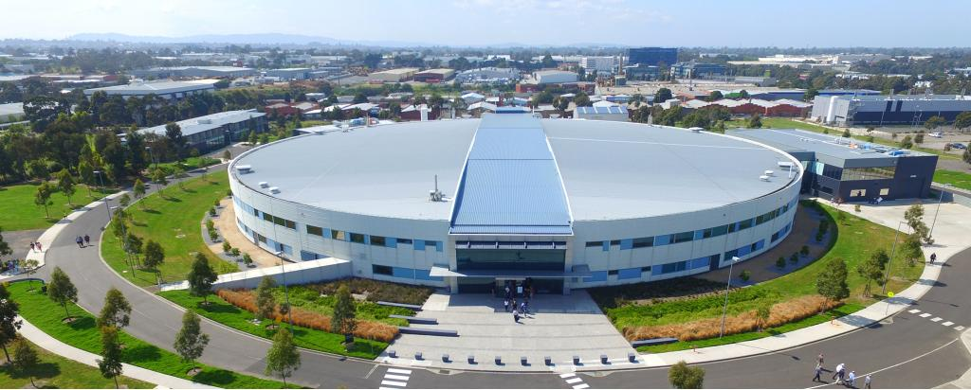
Large-scale x-ray facilities
What do they do?
Australian Synchrotron
Speed up electrons to high speeds
Special magnets
Very bright x-ray beams
An X-ray free-electron laser

Slide 3
What do we use them for?
An x-ray “pattern” from a protein nanocrystal
E.g.
Atomic structure of materials
Proteins
Chemical reactions
Medical imaging
3D imaging of materials
Elemental analysis
And much more
Access is free, but competitive!

Slide 4
“Big Data” @ X-ray laser facilities
High-throughput imaging experiments have substantial data requirements:
100s or 1000s of x-ray patterns per second
~50 hour experiment.
= 1 – 200 Tb of data per experiment
Stored at the x-ray facility on Linux-based servers
Access the facility’s servers remotely to analyze data

Slide 5
The data life cycle in x-ray laser science
Proposal accepted
(hopefully!)
A few months
~3 months
Write an experiment proposal
Experiment
(2-5 days)
START
Publication & Data sharing
Data analysis
(up to 2 years)

Slide 6
Coherent X-ray Imaging Data Bank
https://www.cxidb.org/index.html
Uses a standardized format based on hdf5 (https://www.hdfgroup.org/solutions/hdf5/)

Slide 7
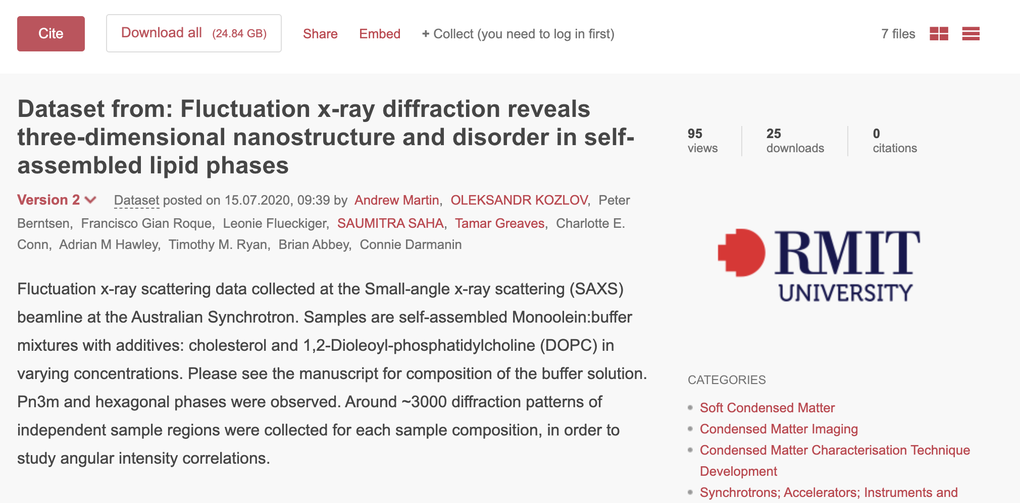
Figshare - https://rmit.figshare.com
Recently shared more modest datasets (1000s of patterns; 3-25 Gb)
Easy to use. Provides a DOI for citation.

